Slide 1
Selective Inference
Yoav Benjamini
Tel Aviv University
Swiss summer school at Villars-sur-Ollon
Lecture 3, September 4, 2018
Preparation Supported by European Research Council grant: PSARPS
www.replicability.tau.il

Slide 2
Outline
Current replicability problems in Science
Selective inference - the silent killer of replicability
Simultaneous inference
False Discovery Rate (FDR)
Tests and confidence intervals controlling FDR and FCR
Estimation and Model Selection
Hierarchical families
Conditional inference
Simultaneous over the selected

Slide 3
Hierarchical testing of families
eQTL: The level of expression of each gene may be modified by the
structure of a SNP identified by its location.
A tested hypothesis *Tested and rejected
What Genes have expression affected by
SNPs located nearby, and which ones?
What SNPs have distal effect on the
expression of genes, and on which ones?
1st level: gene-expression
2nd level:SNPs in locality of gene
1st level: SNPs
2nd level: Genes distal to the SNP

Slide 4
Hierarchical testing of families
H_{ij} are hypotheses in family F_{i}, j=1,..m_{i} (= |F_{i}| ); i=1,…,m
with Y ={ Y_{ij}} or with p-values P={ p_{ij}} )
S(P) is a selection procedure of families.
|S(P)| the (random) number of families selected.
The control of error E(C) (FDR, FWER, False Exceedance rate and others) on the average over the selected families means
BH over all hypotheses may be too liberal on the family level!

Slide 5
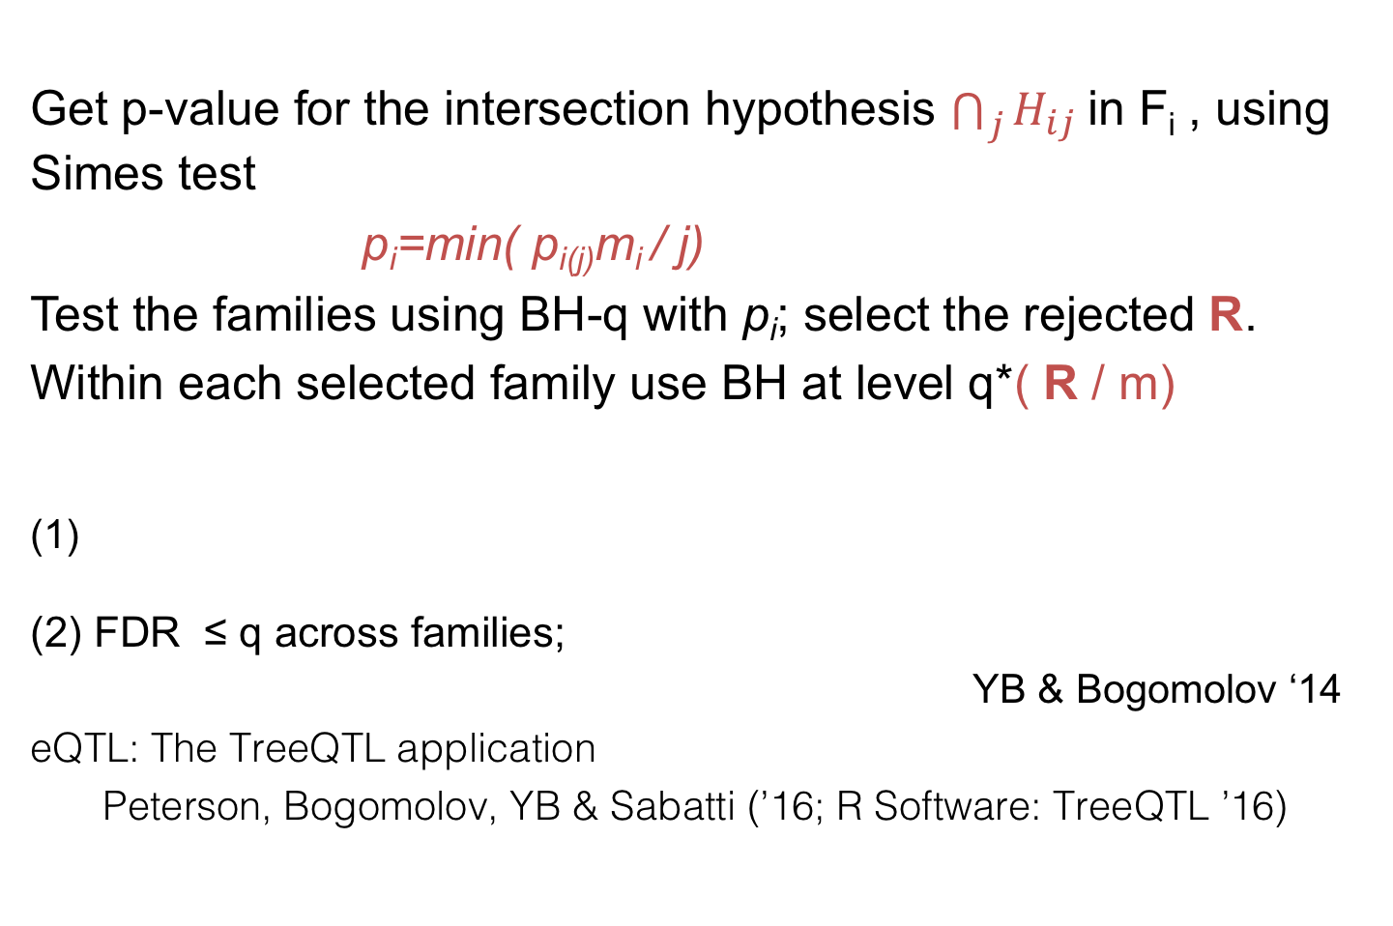
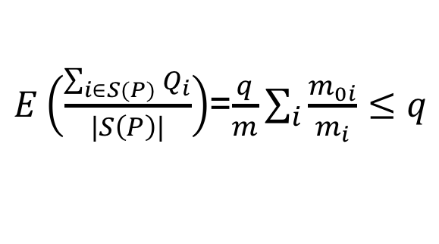
(BH-q, BH-Rq/m) - hierarchical testing
Get p-value for the intersection hypothesis $\bigcap_{j}{H_{ij}}$in F_{i} , using Simes test
p_{i}=min( p_{i(j)}m_{i} / j)
Test the families using BH-q with p_{i}; select the rejected R.
Within each selected family use BH at level q*( R / m)
(1)
(2) FDR ≤ q across families;
YB & Bogomolov ‘14
eQTL: The TreeQTL application
Peterson, Bogomolov, YB & Sabatti (’16; R Software: TreeQTL ’16)
$E\left(\frac{\sum_{i∈S(P)}{Q_{i}}}{|S\left(P\right)|}\right)$=$\frac{q}{m}\sum_{i}{\frac{m_{0i}}{m_{i}}≤q}$

Slide 6
eQTL: SNP in multiple tissues
BH Separate per tissue
Tissues
BH pooled over tissues

Slide 7
L levels in the tree
The error-rate
(
))..)
(
(

Slide 8
eQTL: SNP in multiple tissues
W=1/(3*3*2)
W=1/(1*1*2)

Slide 9

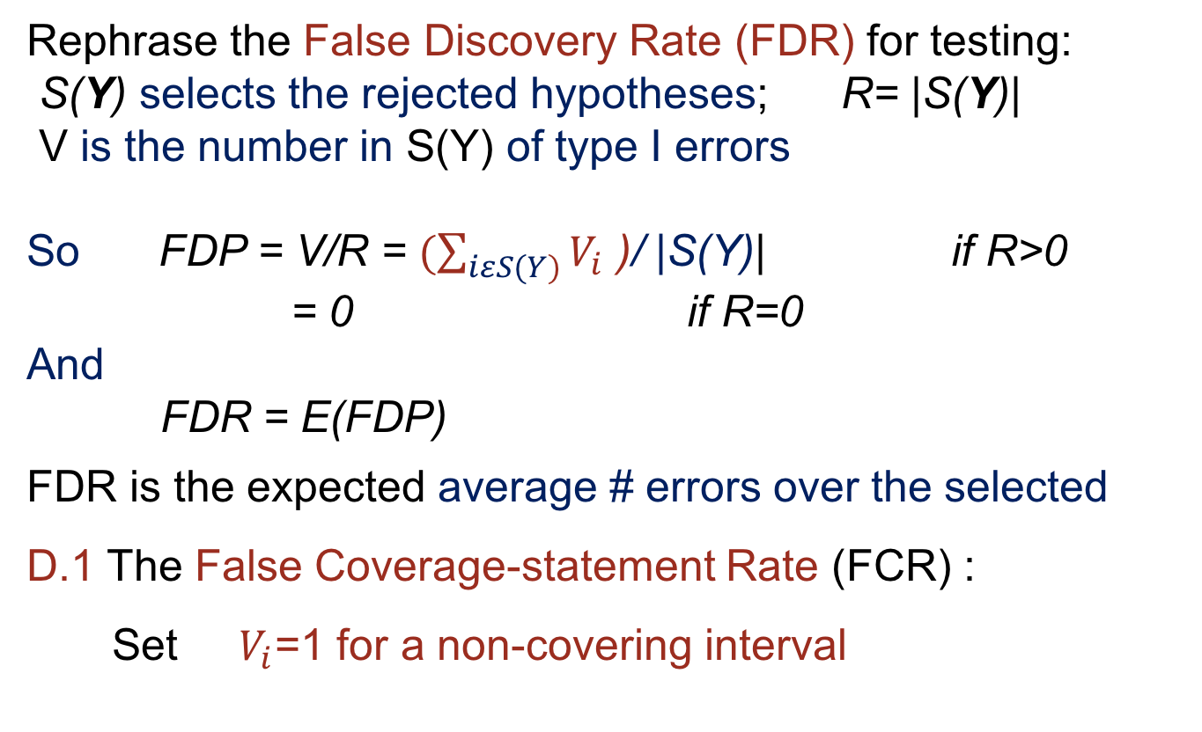

L levels in the tree
The error-rate
(
))…)
(
(
The TreeBH procedure:
Test F^{l}_{i} with BH
at q_{i} ; select S^{l}_{i}
Level l
F^{l}_{i}
Test F^{l+1}_{j} with BH
at
Select S^{l+1}_{j}
$$q_{0}^{l}$$
$$q_{0}^{l+1}$$
F^{l+1}_{j}
Level l+1
$$q_{j}=\frac{\left|\text{S}\text{l}\text{i} \right|}{\left|\text{F}\text{l}\text{i}\right|}q_{i}$$
$$\frac{q_{0}^{l+1}}{q_{0}^{l}}$$

Slide 10
Selection adjusted testing of families
Let H_{ij} be the the hypotheses in family F_{i}, j=1,..m_{i} ; i=1,…,m
with Y ={ Y_{ij}} or with p-values P={ p_{ij}} )
S(P) is a selection procedure of families.
|S(P)| the (random) number of families selected.
The control of error E(C) (FDR, FWER, False Exceedance rate and others) on the average over the selected families means
BH over all hypotheses may be too liberal on the family level!

Slide 11
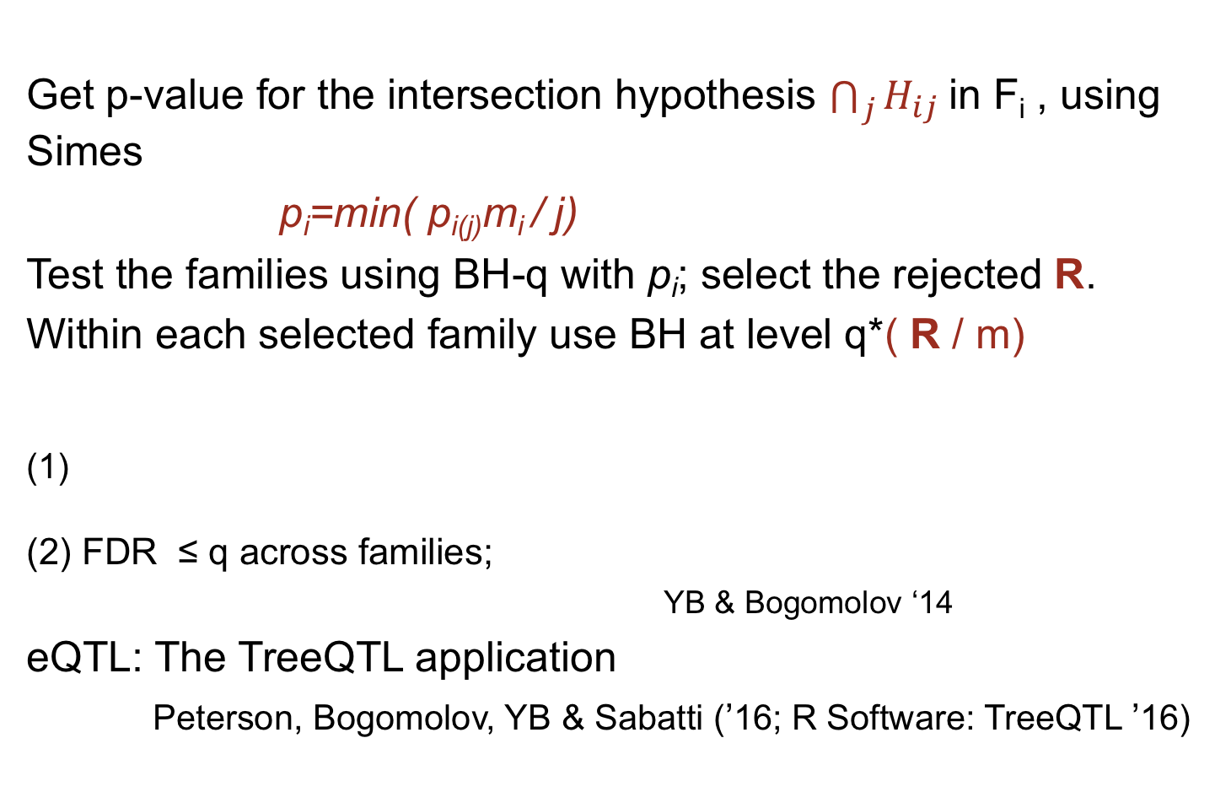
(BH-q, BH-Rq/m) - Hierarchical testing
Get p-value for the intersection hypothesis $\bigcap_{j}{H_{ij}}$in F_{i} , using Simes
p_{i}=min( p_{i(j)}m_{i} / j)
Test the families using BH-q with p_{i}; select the rejected R.
Within each selected family use BH at level q*( R / m)
(1)
(2) FDR ≤ q across families;
YB & Bogomolov ‘14
eQTL: The TreeQTL application
Peterson, Bogomolov, YB & Sabatti (’16; R Software: TreeQTL ’16)
$E\left(\frac{\sum_{i∈S(P)}{Q_{i}}}{|S\left(P\right)|}\right)$=$\frac{q}{m}\sum_{i}{\frac{m_{0i}}{m_{i}}≤q}$

Slide 12
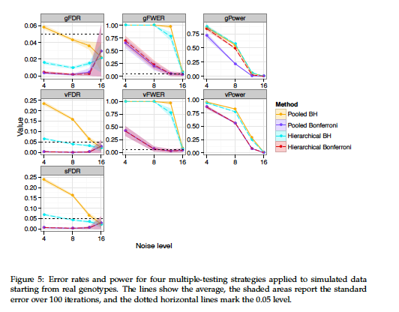
eQTL: The TreeQTL application
Peterson, Bogomolov, YB & Sabatti (’16; R Software: TreeQTL ’16)
Error-rate control: over-all (gFDR) and averaged over the selected (sFDR)
Noise Level
100 simulations starting from real genotype data

Slide 13
eQTL: The TreeQTL application
YB @ JSM2017
Power: small gain; sometimes loss; stronger inference
Noise Level
100 simulations starting from real genotype data

Slide 14
eQTL in multiple tissues
YB @ JSM2017

Slide 15
More than 2 levels in the tree
YB @ JSM2017
If
(i) BH is valid for the dependency structure in each family in the tree, and
(ii) the p-values in a family at level l are independent of those at lower levels that are not their ancestors,
TreeBH guarantees
sFDR^{l} ≤ q^{(l)} for all l=1,2,…L
Bogomolov et al (‘17+)
The idea: If you make a type I error at level l-1 you have to make it also at higher levels, but more may accumulate.
Then use recursively the method of proof used in the 2 levels

Slide 16
eQTL analysis: Peterson et al, Bioinformatics (’16) 2-layers
Heller et al (‘17+) 2 Layers
Peterson et al (‘16); Bogomolov et al 3-layers, L-layers
"Prevalence of sexual dimorphism …" Karp et al, Nature Comm. (‘17)
”Identifying phenotypic abnormalities and sexual dimorphism from rare event mouse phenotyping data” Karp…White et al, Genetics (‘17) - methodology explained
Ramdas, Foygel-Barber (’16), Kozlovski et al (17+)

Slide 17
eQTL analysis: Peterson et al, Bioinformatics (’16) 2-layers
Heller et al (‘18) 1st layers BH with conditional 2nd layer
Ramdas, Foygel-Barber (’16),
"Prevalence of sexual dimorphism …" Karp et al, Nature Comm. (‘17).
”Identifying phenotypic abnormalities and sexual dimorphism from rare event mouse phenotyping data” Karp…White et al, Genetics (‘17) - methodology explained
Kozlovski et al (17+)

Slide 18
Association of gut microbiome with Colon Cancer
# microorganisms 496
N= 177 (86 tumors)
Abundance determined by rDNA & compared between cancer and normal
Offers selective inference at the levels of Phylum, Class, Order, …. Species
Bogomolov et al (‘17+)

Slide 19
Association of gut microbiome with Colon Cancer
There is interest in inference that stops at a family, genus etc. with no particular species identified.
The end-nodes become the selected set

Slide 20
Screening clinical symptoms of Parkinson patients for genetic effects by hierarchical testing
Screening the 743 multiple regression models
In the 32 passing FDR at .05, test coefficients at q*(32/743)

Slide 21
Other hierarchical methods
YB @ JSM2017
eQTL in tissues Heller, Chatterjee Krieger et al (‘17).
Collapse levels 1 & 2 of SNPs and Genes to one family, family 1’
Tissues per pair of SNP & Gene-expression are families at new level 2’
Tissues are taken from different subjects hence are test statistics in each family independent. So,
Test associations per tissue and use Fisher’s combination test per family in level 2’
Test using BH at level 1’.
Within a selected family calculate conditional p-values
(no longer independent but still managable)

Slide 22
Other hierarchical methods
1. eQTL in multiple tissues Heller et al (‘17)
Using 2-layers: selecting from the 1st controlling FDR
selecting from the 2nd by conditional p-values
2. The p-Filter for multiple groups Barber-Foygel & Ramdas (‘16)
Goal: control both group level and overall level FDRs
Idea: choose separate thresholds t_{group} and t_{overall}
t_{group} operates on the Simes p-values for the groups
t_{overall} operates on the individual p-values.
Maximizing computationally both, s.t. control of empirical FDPs
Further generalized to multi-level (by defining relevant families) and weights Ramdas et al (’17+)
3. Knockoff Candes et al (18+)

Slide 23
The “p-filter” multilayer FDR control for groups
YB @ JSM2017
Foygel-Barber and Ramdas ’16
Goal: control both group level and overall level FDRs
Idea: choose separate thresholds t_{group} and t_{overall}
t_{group} operates on the Simes p-values for the groups
t_{overall} operates on the individual p-values.
Maximizing computationally both,
under constrains on estimated FDP_{overall} and FDP_{group}
is proven to controls their expectations
Ramdas et al ’18 further generalized to multi-level (by defining relevant families) and weights

Slide 24
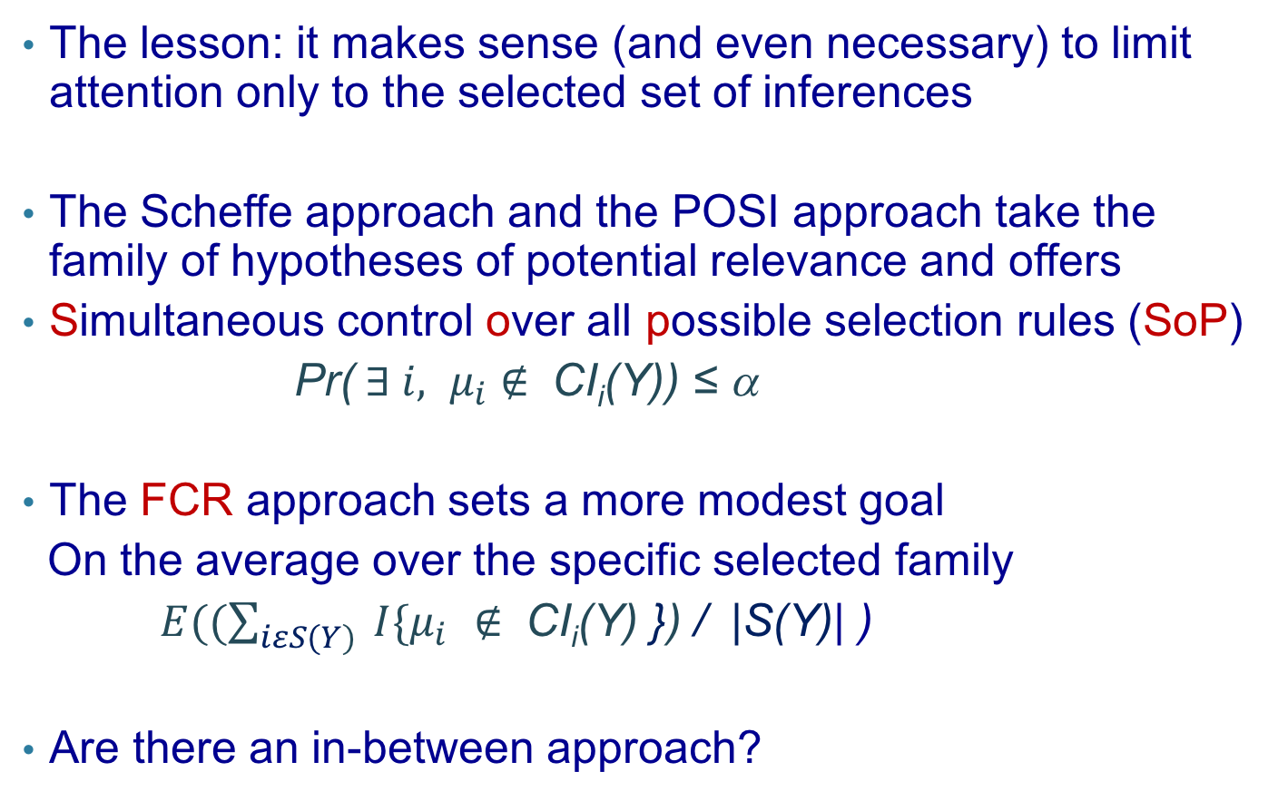
The lesson: it makes sense (and even necessary) to limit attention only to the selected set of inferences
The Scheffe approach and the POSI approach take the family of hypotheses of potential relevance and offers
Simultaneous control over all possible selection rules (SoP)
Pr(${ ∃ i, μ}_{i}$ $∉ \text{CI}\text{i}\text{(}\text{Y}\text{)}$) ≤ α
The FCR approach sets a more modest goal
On the average over the specific selected family
$E((\sum_{iεS(Y)}{{ I\{μ}_{i} ∉ \text{CI}\text{i}\text{(}\text{Y}\text{)}}$ }) / |S(Y)| )
Are there an in-between approach?

Slide 25
Error-rates for addressing selective inference
Simultaneous over all possible selection rules (SoP)
Simultaneous over the selected (SoS)
Conditional over the selected (CoS)
On the average over the selected (FDR/FCR)

Slide 26
The FCR adjusted performance
Simulated data
10,000 parameters θ_{i} generated (once) as following:
λ_{i}=10 w.p. .1
=1 w.p. .9
Y_{i} ~ N(θ_{i},1)
Selection rule: BH at q=0.2
CIs: 95%
Note no parameter for which θ_{i} = 0 is true so FDR=0
But CIs offer directional error control

Slide 27
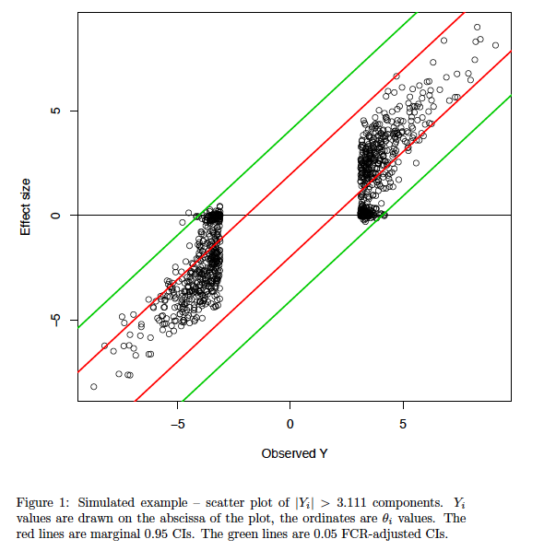
The problem?
The success
Ex 1 Give a selection procedure where the “success” will be in the upper direction

Slide 28
Conditional Quasi-Conventional CI
Design acceptance region for testing θ=θ₀ that:
  Have correct level under the conditional distribution
  Are as short as possible
  Avoid including observations of opposite sign to θ₀
  Invert them to get conditional CIs.
  Following YB,Hochberg & Stark (‘98)
  “Non-equivariant confidence intervals:
  two ends control the means”
Such intervals will also control the FCR
Weinstein & Yekutieli (15+)

Slide 29
Utilizing the selection procedure via conditioning
(2) Inference on being |larger| than a threshold
E.g. Select θ if its estimator is big enough
X=(Y | |Y| ≥ c),
where c is either fixed or (simple) data dependent c(Y).
Conditional density
Acceptance region for each parameter (non-equivariant) with short 0-crossing -> inverting to get Conditional CIs -> offer FCR

Slide 30

Conditional Quasi-Conventional (CQC) CI
Following the work on CI that are more likely to determine the sign (YB Hochberg & Stark, ‘98)
The goal: Compromise between sign determination and length
Remark: Two-sided one-sided CI:

Slide 31
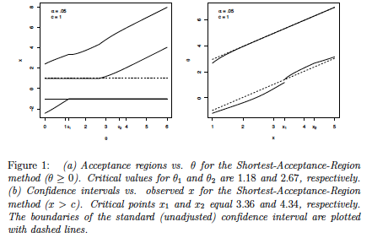
The shortest acceptance regions

Slide 32
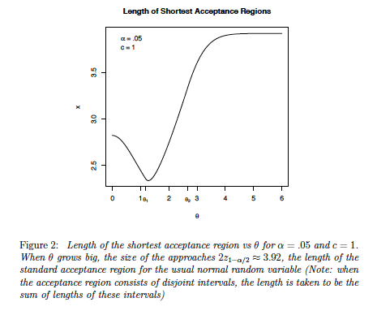
How well did we do

Slide 33
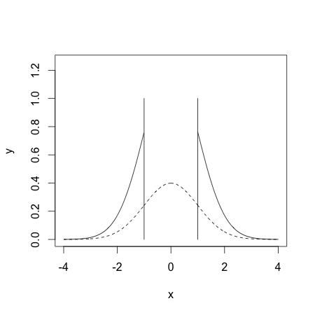
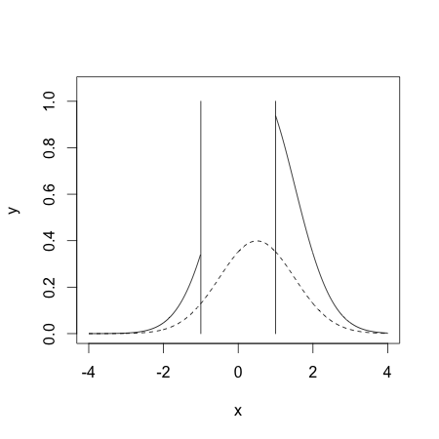
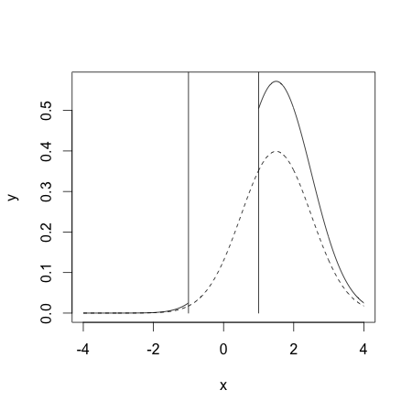
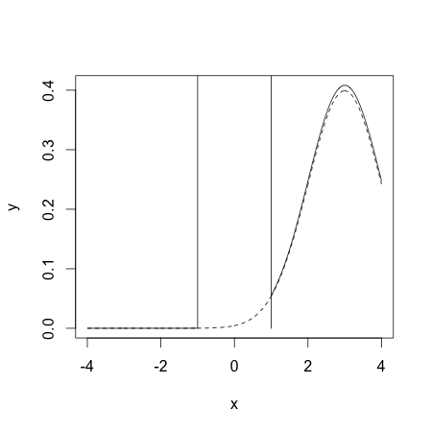
The complication: θ is no longer only a shift parameter

Slide 34
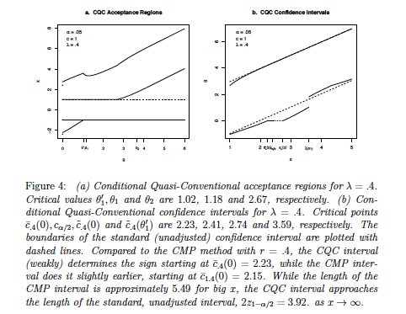
The Conditional Quasi-Conventional AR & CIs

Slide 35
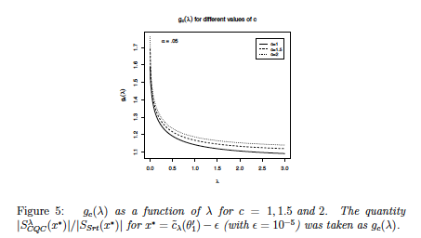
The choice of λ:

Slide 36
Application: Addressing ‘Voodoo Correlation’
Estimating quantities of interest correlated with brain activity from the same data used to locate the most promising ones. (Behavioral Neuroimaging).
Vul et al 2009 ‘blew the whistle’ on the practice.
It took a few years, heated debate, and a joint paper by 8 experts to realize the problem is of selective inference
(named also ‘Circular reasoning’, ‘Double Dipping’)
and that:
Voodoo correlations are everywhere…
Their proposed solution: data splitting

Slide 37
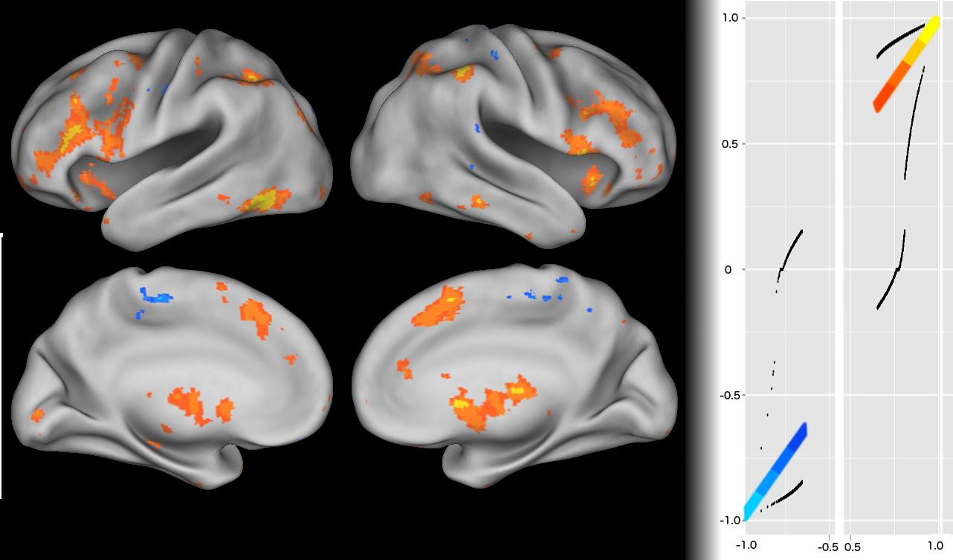
Addressing ‘Voodoo Correlation’ with conditional CIs
Confidence Calibration Plot: Observed correlations in
significant voxels (B-H;FDR 0.1) encoding
conditional confidence intervals as well.

Slide 38
Addressing ‘Voodoo Correlation’ with conditional CIs
Long to do list: dealing with data dependent threshold,
inference on regional means and regional maximum

Slide 39
Previous and current work on conditional inference
Hodges (‘84) For meta-analysis
Zhong &Prentice (‘08) For GWAS using asymptotic approximation
J. Taylor and his coauthors and students:
P-values and CI post selection of a model using a Lasso
  Asymptotic p-values Lockhart, Taylor, Tibshirani, J.Tibshirani (14)
  Exact post-selection inference Lee, Dennis Sun, Yuekai Sun,Taylor (13+ )
P-values & CIs post screening variables with marginal significance then fitting using some model selection (AIC, Lasso, …) Tian Lotfus, Reid, Choi (14+,14+,14+,15+)
Post selecting a parameter with estimator > threshold
Fithian, Sun, Taylor (14+)
| |
Lee

Slide 40
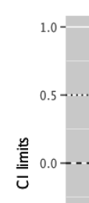
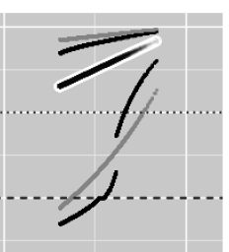
FCR intervals vs Conditional Quasi-Conventional
FCR
Conditional
Ex 2. Add to the comparisons the confidence intervals of Fithian and al

Slide 41
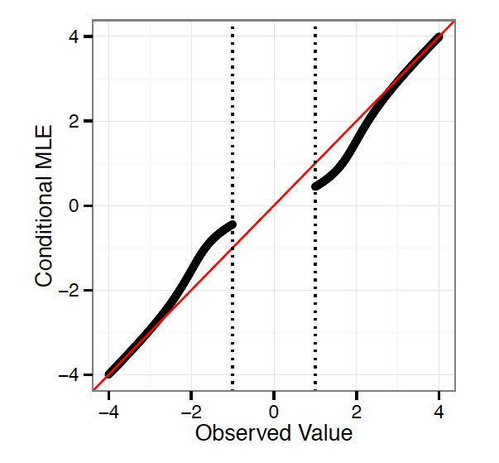
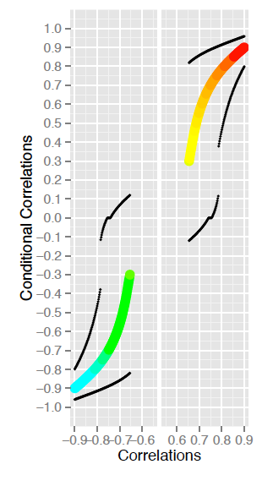
The maximum conditional likelihood estimator
In Fithian Sun & Taylor terminology: 100% used for selection
Ex 2: Try to design an estimator after one sided test – compare to the above

Slide 42
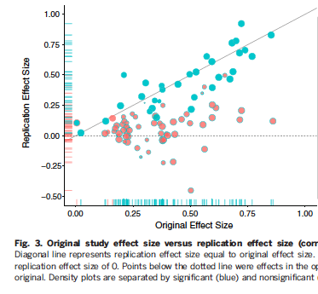
The file-drawer/publication-bias problem
The psychology reproducibility (replicability) project
Complication: effect size is X/sd(X); solution conditional inference on non-centrality

Slide 43
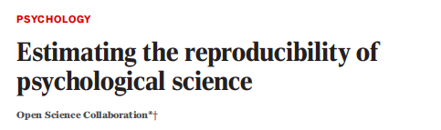
Con
With estimators and CIs conditional on p-value ≤ 0.05
77% fall in
Cond. CI
Instead of
47%

Slide 44
Thresholding at
p-value ≤ 0.05
Thresholding at
p-value ≤ 0.005

Slide 45
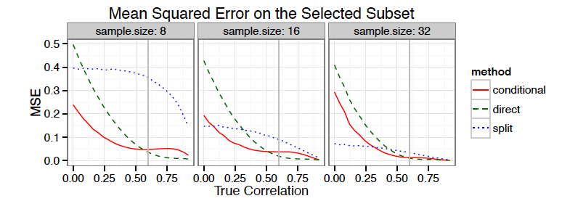
A new paradigm for comparing performance
Carved estimation seems to further improve estimator in larger problems

Slide 47
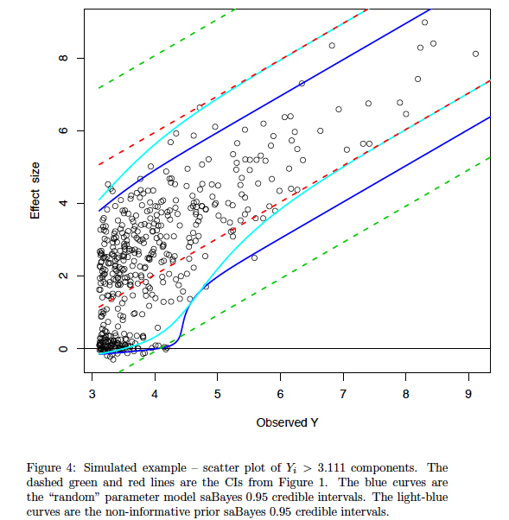
Yekutieli’s selective adjusted Bayes (‘13)

Slide 48
Conditional inference in “the selected model”
Generalizing the above to test max(|X₁|,|X₂|)
If ind. no problem Pr_{μ} (|X₁|≥|X₂| | |X₂|= |x₂| )
This can be viewed as 1st step in model selection with
Conditional inference in the saturated model inference
Once model {1} selected one can ask for inference in the selected model i.e., when μ₂=0
Fithian, Taylor, Tibshirani & Tibshirani (15+)

Slide 50
But what happens under dependence?
Condition on the perpendicular to the projection of X on X₁
i.e. condition on the residual vector
after regressing X₁ on the others.

Slide 51
Inference on bumps
Benjamini Yuval, Taylor & Irrizari (‘18)

Slide 53
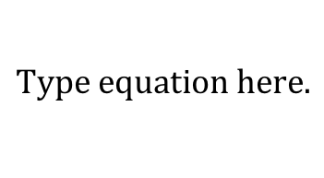

Selective inference for Lasso (conditional)
Lee, Sun, Sun & Taylor (‘14)
Goal: CI covering
$$β_{\hat{M}}$$

Slide 62
Reflections
The FDR confidence intervals, for all parameters were suggested by Tukey (’94, NISS , e.g. interview in 96 and in Williams et al, ‘99).
Tukey viewed them more as “gauges” for testing, to be supported by simultaneous CI.
Efforts to reconcile the two ( in early version of Williams et al 99)
Encountering with modern large problems, where there is often no interest in the unselected set of parameters, made us to switch our point of view and suggest selective CIs with relevant non- coverage criterion of FCR
As well as the notion of “on the average over the selected” as one goal for addressing selective inference

Slide 63
Tukey said that he liked statistics because it allowed playing in the backyard of many sciences
We have an opportunity - in fact a call from scientists – to play in their front yard
We should not miss the call

Slide 64
Error-rates for addressing selective inference
Simultaneous over all possible selection rules (SoP)
Simultaneous over the selected (SoS)
Conditional over the selected (CoS)
On the average over the selected (FDR/FCR)

Slide 65
SoS: Utilizing the selection procedure used
(1) max(X_{i})
Hechtlinger, Stark & YB (14+)
Example : Studying the effect of a pre-specified risk factor:
Morbidity ~ β_{1.{1}}*Risk factor + ε
Effect of Risk Factor adjusted for Age and Gender:
Morbidity ~ β_{1.{1,2,3}}*Risk factor+Age +Gender +ε
The abstract carries merely the largest of the two β’s and its 95% confidence interval
Goal: Design a (single) CI for the largest
Can we do better than β_{max} ±se(β_{max})z_{1-α/4} ?

Slide 66
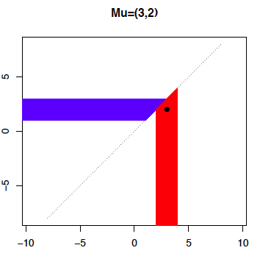

Acceptance regions for μ (non-equivariant)
Hechtlinger, Stark & YB
μ₁>μ₂

Slide 67
Confidence intervals for μ_{i}
Hechtlinger, Stark & YB
x₁=3 and x₂=2
x₁ > x₂
CIμ₁=3±c

Slide 68
Acceptance regions for μ : How big should c be?
Hechtlinger, Stark & YB
μ₁>μ₂

Slide 69
So c=z_{1-α/2} : CI for max of two is like CI for one parameter!
Hechtlinger, Stark & YB
Holds for correlated bivariate normal as well

Slide 70
For maximum of m>2
Hechtlinger, Stark & YB
In general under independence: = one-sided maximum modulus
Conjecture: the CI remains conservative for PRDS

Slide 71
max |x_{i}|
Hechtlinger, Stark & YB

Slide 72
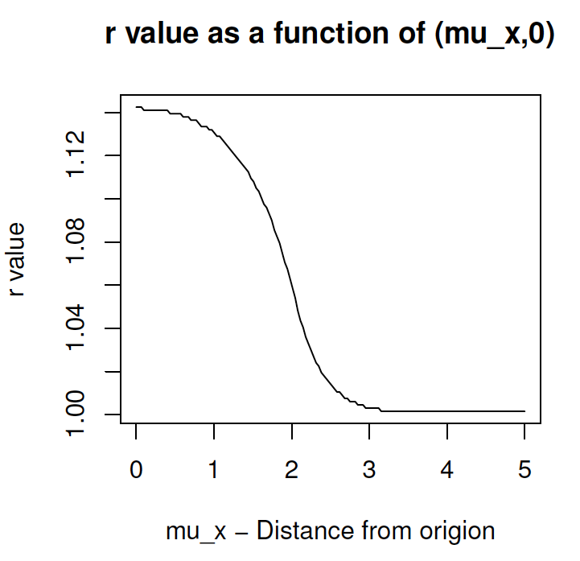
When away from the origin, again no inflation is needed

Slide 73
SoS intervals for the largest k estimators out of m
Hechtlinger, Stark & YB
F symmetric, X_{i} - μ_{i} ~ F, i=1,2,…,m.
Define SoS CI_{α} for μ _{(i|m)} by X _{(i|m)} ±c_{α} for i=1,2,…,k < m/2
V_{i}⁺=1 if (X _{(i|m)} – μ _{(i|m)} ) > c_{α} 0 otherwise V⁺=Σ^{k} V_{i}⁺ V^{+* +}=Σ^{m} V_{i}⁺
V_{i}⁻=1 if (X _{(i|m)} – μ _{(i|m)} ) < -c_{α} 0 otherwise V⁻=Σv_{i}⁻
Pr_{μ}{ V_{i}⁺=1 U V_{i}⁻ =1 }
Pr_{μ}{ V_{i}⁺=1 } + Pr_{μ}{ V_{i}⁻ =1 } ≤ Pr₀{ V_{i}⁺=1 } + Pr₀{ V_{i}⁻ =1 }
≤ Pr₀{ V_{i}^{+*}=1 } + Pr₀{ V_{i}⁻ =1 }
≤ E(V^{+*} )+ E(V⁻) = Σ^{m} E(V_{i}⁺ ⁾ + Σ^{k}Ε(V_{i}⁻)
=m(1-F(c_{α})) +k(1-F(c_{α}))
so c_{α}=F⁻¹(α/(m+k))

Slide 74
SoS: Utilizing the selection procedure used
(3) Closed testing
Goeman& Solari (11)
Select hypotheses to reject by a closed testing procedure C
Take any subset S of interest of hypotheses from C,
And you can have a 1-α confidence set
for the number of false rejections in S.

Slide 75
Closed testing
Marcus, Peritz & Gabriel
Local Tests of
intersection Hypothesis
Reject H₁
But not H₂ or H₃
Χ = { Η₁}

Slide 76
“Multiple testing for exploratory research”
Goeman& Solari (11)
C is the set of families whose intersection was rejected and any family containing them was rejected
(using weak FWER, such as Fisher, Simes, and such))
R family of hypotheses from C,
And {0,1,… } is a 1-α confidence set
for the number of false rejections in R.
Note that if R is not in C =|R| i.e. not relevant

Slide 77
Take away messages
While Berk et al (2013) offered an ‘good for all ‘ method, it seems too conservative for practical use in high dimensions.
The selective inference procedure can benefit from being tailored to the selection method
There is more than one way to do it.
In most cases performance “on the average over the selected” is enough

Slide 78
Proportion of papers devoted to MCP in: Annals of Stat. Biometrika, JASA, JRSS B
Tukey’s comment
Personal Note
Micoarrays
MCP1996

Slide 79
Thanks to my collaborators and students
UC Berkeley Philip Stark
Upenn Asaf Weinstein
Stanford Chiara Sabatti#, Will Fithian
Weizmann Inst. Jonathan Rosenblatt,
Washington U Amit Meir
Technion Marina Bogomolov
Tel Aviv Univ. Ilan Golani, Zoology*
Ruth Heller, Statistics*
Neri Kafkafi, Computational Biologist*
Daniel Yekutieli, Statistics*
Mira Marcus-Kalish^,
PhD and MSc students*
Tal Lahav, Neta Shachar*^, Yair Vexler, Tal Galili*^, Yotam Hechtlinger, Dan Warshavski
*ERC Practical Statistical Approaches to Replicability Problems in Life Sciences
^ERC Human Brain Project
#NIH grant awarded to Stanfors

Slide 80
Tukey said that he liked statistics because it allowed playing in the backyard of many sciences
Addressing replicability is an opportunity - in fact a call from scientists – to play in their front yard
We should not miss the call

Slide 81
Selective Inference: On the average over the selected
When addressing a family of inferences (tests, estimates, CIs) we wish at least to assure that the property of the individual inference will still hold on the average over the selected
For Confidence Intervals
The False Coverage-statement Rate (FCR) of a selective
CIs procedure is the expected proportion of coverage
statements made that fail to cover their respective parameters

Slide 82
2.1 We can have general FCR controlling CIs
(1) Apply any (simple) selection criterion S(T)
(2) For each i ε S(T),
construct a marginal 1- q |S(T)| / m CI
If the components of T are independent
FCR ≤ q.
Conjecture: remains true for Gaussians with positive average correlation
Implications:
For “select all” (= no-selection) use marginal CIs

Slide 83
General: FCR adjusted selective CIs
(1) Apply the selection criterion S(T)
(2) For each i ε S(T), partition T to T_{i} and T^{(i),}
R_{min} (T^{(i)})=min_{t} { |S( T^{(i)},T_{i}=t)| | i ε S(T^{(i)},T_{i}=t) }
(3) For each i ε S(T )
construct a marginal 1- R_{min} (T^{(i)})q/m CI
Theorem: For any selection procedure S(), if
each marginal CI is monotone in α ε (0,1)
(ii) the components of T are independent,
The FCR-adjusted CIs defined before enjoy FCR ≤ q.

Slide 84
When should we use what: back to examples
Tomatoes and Prostate Cancer
Selective inference suffices. If we find a list of related food intakes that are found to reduce the relative risk (RR), it is not essential to be certain about each and one of them together at level .05.
FDR testing and/or FCR control of selected CIs are good enough.
When CIs for RR of the food intakes selected are subject to FCR-adjustment at .05 - they all cover 1 !

Slide 85
Hormone Therapy - the confusion in goals
3 pre-selected major outcomes: Breast Cancer (primary adverse), Coronary Heart disease (primary), and an index of global outcome
7 other major outcomes, related outcomes and composite outcomes (e.g. total cancer).
The authors defend using the unadjusted intervals for the three major outcomes by emphasizing that they were designated to serve as such in the monitoring plan. Their revealed concern: selection effect (preselection does not assure simultaneous coverage)
But as to the less important other 7 outcomes, they state that the reason they should report the Bonferroni intervals is because the marginal ones fail to offer simultaneous coverage.

Slide 86
Hormone Therapy - the confusion in goals
Had they the tools to realize that their concern is selective inference, and had they used FCR-adjustment on the 7 other major outcomes - the results would have been very close to the unadjusted intervals (the solution they chose).
In fact, it makes sense to require simultaneous inference for the group of 3 preselected major outcomes, as the conclusion from the trial is dependent on assessing jointly their values.
This need not involve Bonferroni, but methods better tuned to the needs of such a study which still offer simultaneous inference for the 3 outcomes
Madar Stark &YB (‘13)

Slide 87
A pause: better simultaneous CI by breaking the rules
Acceptance regions

Slide 88
Acceptance regions

Slide 89
Not translation invariant
Generally biased (unless far)
Non-unique (can have for two different parameters the same acceptance set
Difficult to invert
BUT can determine the sign better

Slide 90
Bivariate Confidence sets and CIs

Slide 91
Almost too good to be true

Slide 92
Recall that regular simultaneous CIs were against the clinical recommendations
The Quasi-Conventional simultaneous ones support them
End of diversion
But the flexibility offered by ignoring translation- invariance will remain

